Slide 1
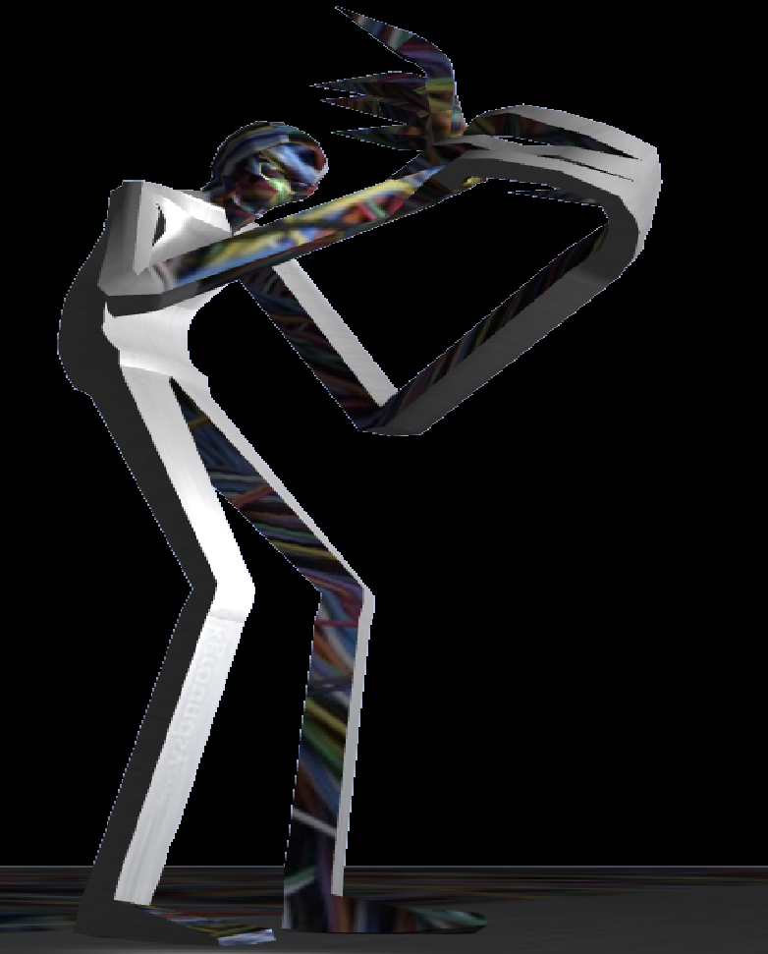
Horror Arena

Slide 2
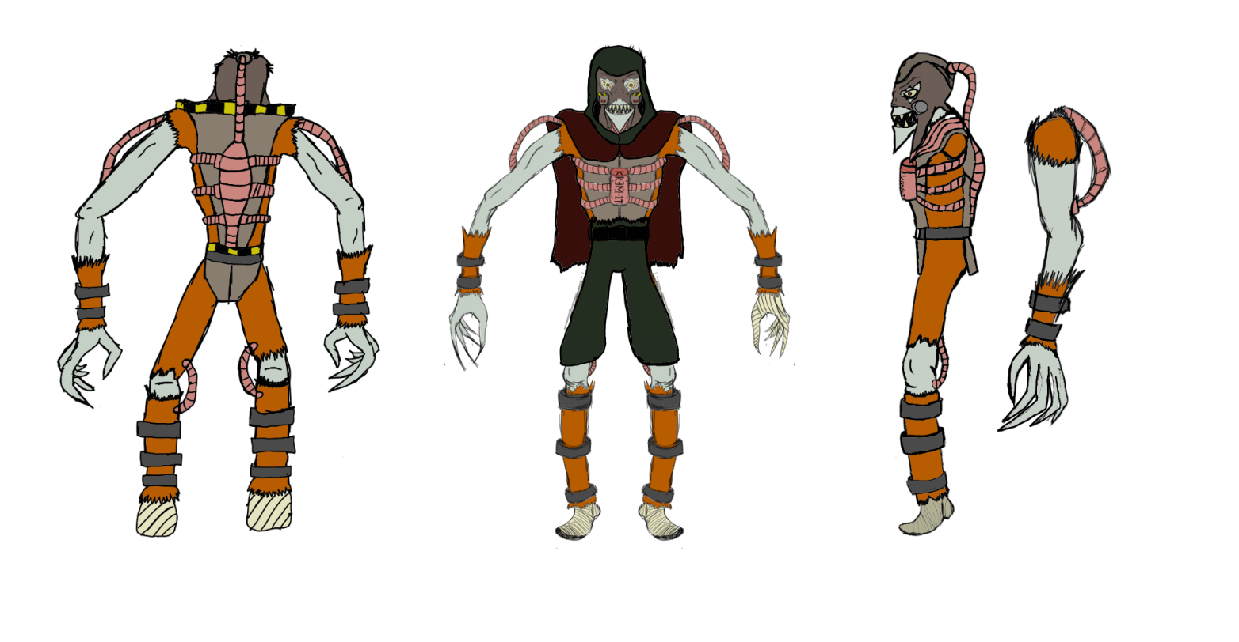
Selling Point
Adrenaline-inducing and Fast Paced.
Like every fighting game your reflexes and your reaction time will be hardly tested by your opponent.
Multiplayer 1 Vs 1.
Gather your friends for have fun together in the final Tournament.
Many different Characters with different Move Sets.
Inspired by the creepiest Sci-Fi settings.
Old School looking game.
Punch someone in the face is never out of style.

Slide 3
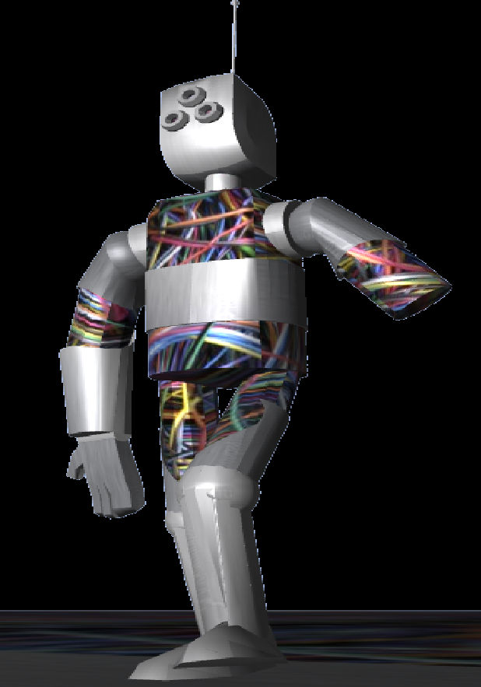
Overall structure
Menu:
Instructions
Character’s menu
In game Pause menu (for go back to the main menu)
Quit
Game:
3 different Maps
7 different Characters
2 minutes rounds (default) or personalised options
3D Graphics and settings

Slide 4
Game mechanics high priority
Controls for Player 1:
W,A,S,D = Movement F = Punch G = Block
Controls for Player 2:
Arrows = Movement 4 = Punch 5 = Block
Other Mechanics:
Best of three matches (default) or personalised options
Clear HUD showing: Health Bar, Number of rounds won and timer

Slide 5
Game mechanics Low priority.
Stamina bar, to regulate the gameplay`s flow.
Pressing the Block button would effectively block only for a certain amount of time.

Slide 6
Attract mode
Brief Gameplay after 20 seconds of inactivit recorded by OBS , including sound effect and music

Slide 7
Question time! Tell us what you think about it!

Slide 8
Thank you kindly for your attention and suggestions. We are looking forward for you to play our game!

